Slide 1
Presentation Java
Mobile Programming
Student: Shukirillaev Mukhammadsodik, 202438379

Slide 2
Our First Program
01
Of course it is “Hello World!”

Slide 3
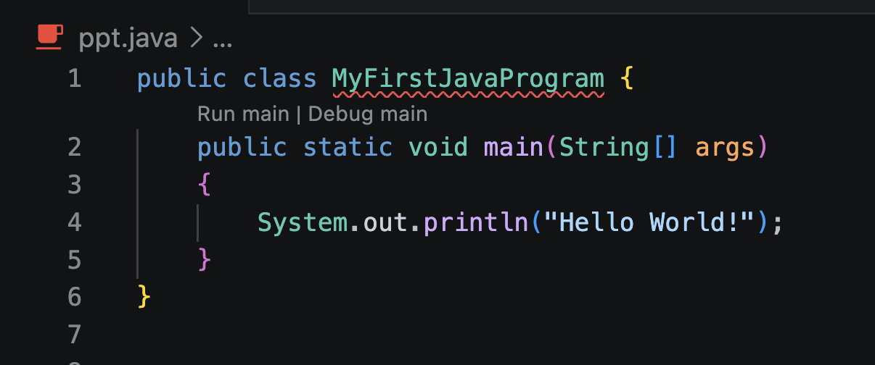
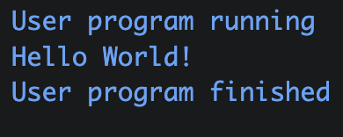
Our first program in any language:
‘Hello World’
A Java program starts with a class, the filename must match the class name exactly
The main() method is the entry point; JVM calls it automatically when the program runs
public means it's accessible from outside (like by the JVM)
static means JVM can call it without creating an object first
void means the method returns nothing (similar to Python's def)
String[] args holds any arguments passed from the command line
System.out.println() prints text to the console
Notes:
Java Virtual Machine

Slide 4
Comments
02
2 types of comments

Slide 5
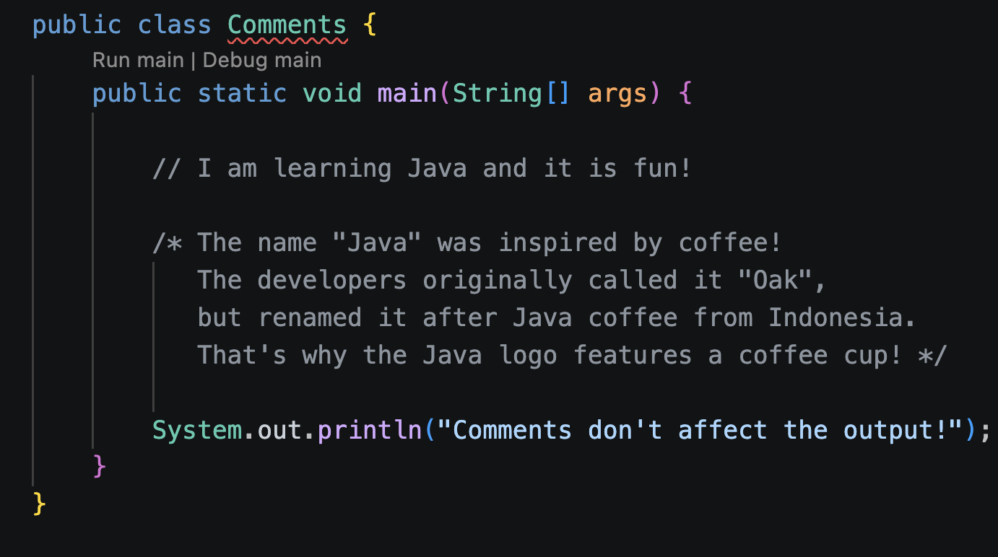
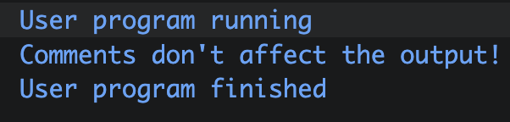
Comments
Single-line comment:
// ..
— everything after it on that line is ignored
Multi-line comment:
/* ... */
wraps across multiple lines
Comments are for humans, not the compiler. We use them to explain our code

Slide 6
Data Types (Numbers)
03
8 main data types

Slide 7
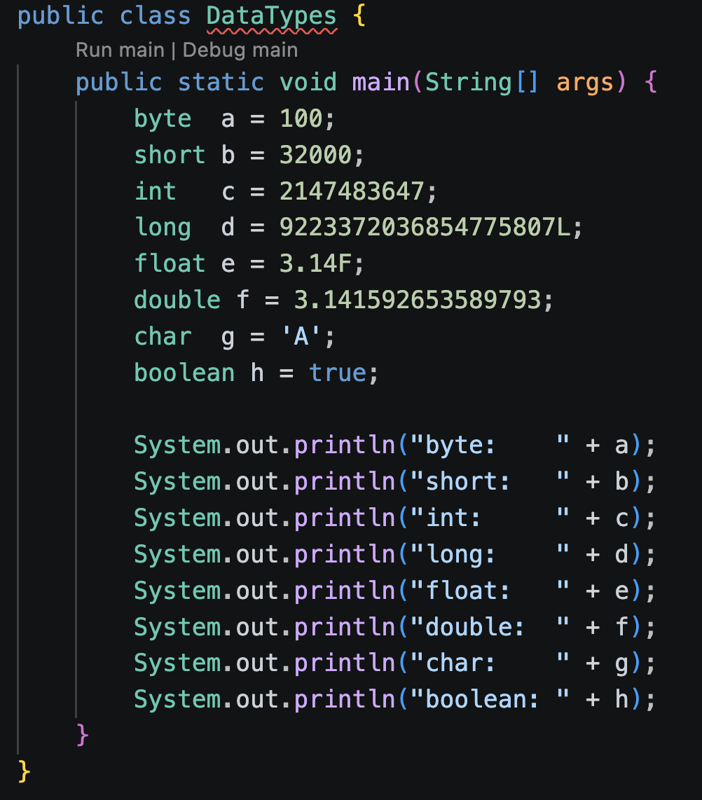
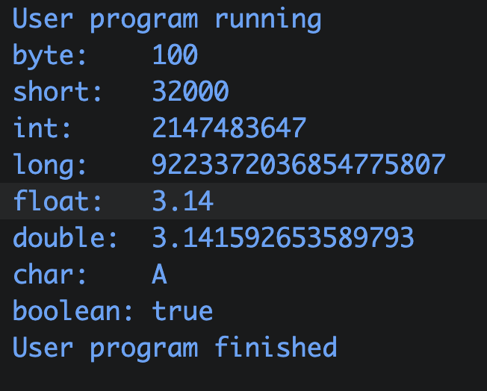
Data Types (Numbers)
Java has 8 primitive types: byte, short, int, long, float, double, char, boolean
int is the default for whole numbers; double is the default for decimals
char stores a single character and uses single quotes 'A' — never double quotes
Wrapper classes (e.g. Integer, Double) wrap primitives so they can be used as objects
The Number class is the superclass of all numeric wrapper types

Slide 8
Arithmetics
04
+ - * /

Slide 9
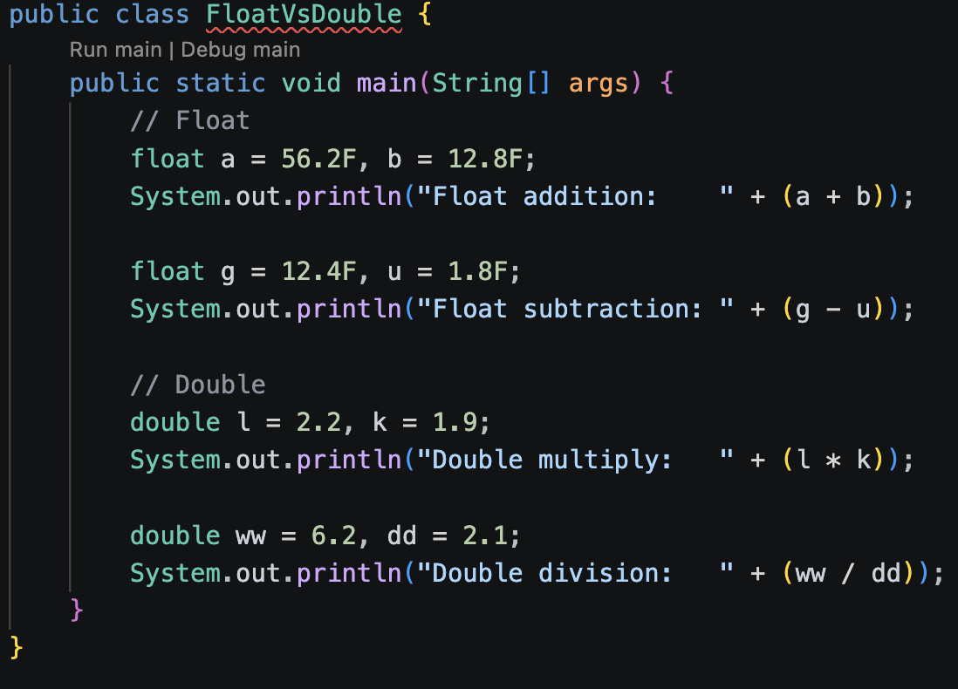
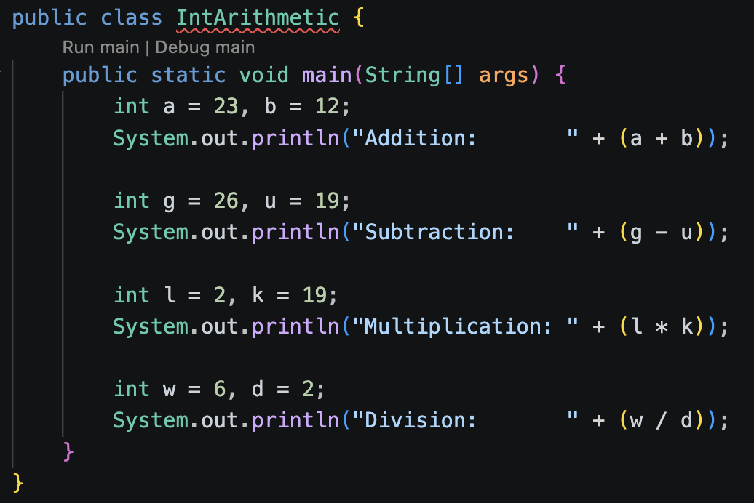
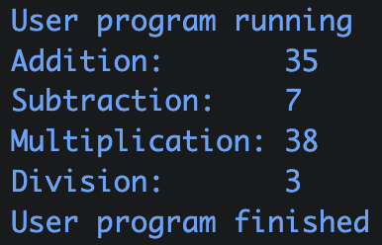
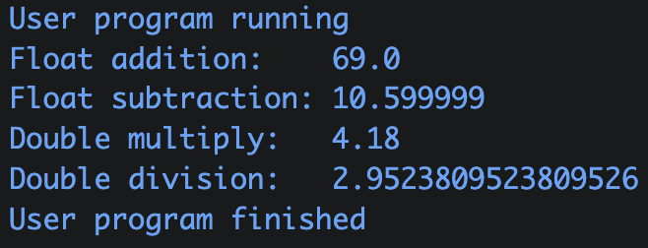

Slide 10
Type Casting (Conversion)
05
324.545 --> 324
324 --> 324.545

Slide 11
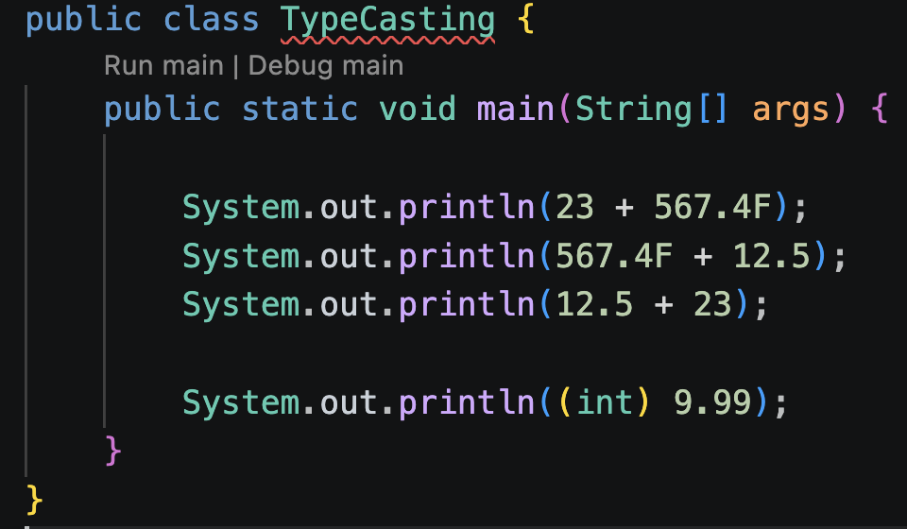
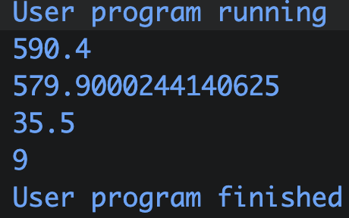
Type Casting (Conversion)
Widening (implicit): smaller type to larger type, done automatically by the compiler, no data loss
Hierarchy: byte → short → int → long → float → double
Narrowing (explicit): larger type → smaller type, done manually by the programmer using (type)
May cause data loss...

Slide 12
Q & A [1]
Why does Java have so many number types instead of just one?

Slide 13
Q & A
To save memory. A byte uses 8 bits, an int uses 32 bits. If you only need a small number, why waste space?

Slide 14
Q & A [2]
What do all these types (int, double, float…) eventually become for the computer?

Slide 15
Q & A
They all become binary (0s and 1s)

Slide 16
THANKS

